Slide 1

INSTITUTE : UIE
DEPARTMENT: ALL ACADEMIC UNITS
Bachelor of Engineering (All Sections)
Subject Name and Code:
Engineering Physics 23SPH-141
Prepared by: Deepak Kumar, Asso. Prof. Physics
FIBRE OPTICS
DISCOVER . LEARN . EMPOWER

Slide 2
Course Objectives
The course is designed to make the students industry ready to contribute in the growing demand of the industry at local, national and international level.
It will make the students competent to understand basic concepts and applications of advanced engineering physics and apply its principles in their respective fields at global platform.
It will enhance the skill level of the students and shall make them preferred choice for getting employment in industry and research labs.
It will give thorough knowledge of the discipline to enable students to disseminate knowledge in pursuing excellence in academic areas.

Slide 3
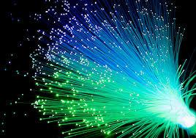
Course Outcomes
CO Number | Title On completion of this course, the students are expected to learn | Level
CO1 | Quote the basic fundamental concepts of lasers, optical fibres, crystallography, ultrasonic oscillations, semiconductor physics, quantum mechanics and nanotechnology. | Remember, Understand
CO2 | Demonstrate the working of various lasers, fibre components, semiconductor devices; explain the behaviour of crystalline solids, quantum and nano-scale systems. | Understand
CO3 | Solve problems by applying principles related to lasers, fibres, semiconductors, oscillations, quantum and nanoscience. | Applying
CO4 | Compare various lasers and fibres, semiconducting devices, crystalline materials, structures at quantum and nanoscale on the basis of their properties for industrial applications. | Analyze
CO5 | Develop various systems using lasers, fibres, semiconductors and nanomaterials for futuristic applications. | Design
Figure 2.1 Optical fibres [1]

Slide 4
Brief Flow of Presentation
Brief Introduction
Optical fiber construction
Critical angle & Total Internal Reflection
Acceptance angle & acceptance cone
Numerical Aperture
V-Number
Types of fibers
Dispersion & its types
Attenuation and Losses in Fiber
Advantages
Disadvantages
Applications
Figure 2.2 Basic structure and parts of optical fibre [2]

Slide 5
Dispersion Types
The dispersion cause that optical pulses to broaden as they travel along a fiber, the overlap between neighboring pulses, creating errors in the receiver output, resulting in the limitation of information-carrying capacity of a fiber.
In communication, dispersion is used to describe any process by which any electromagnetic signal propagating in a physical medium is degraded because the various wave characteristics (i.e., frequencies) of the signal have different propagation velocities within the physical medium.
Types of Dispersion
Dispersion are of two types:
Intra modal or Chromatic Dispersion
Intermodal or Modal Dispersion

Slide 6
Intra modal or Chromatic Dispersion
Intramodal or Chromatic dispersion (CD) is caused by the fact that single mode glass fibers transmit light of different wavelengths at different speeds. The ratio of the speed of light in a medium to the speed in a vacuum defines the index of refraction or refractive index of the material.
Material Dispersion
This is due to intrinsic properties of the material, glass.
Glass is a dispersive medium. We can recall from our high school physics that glass has different refractive index for different colors.

Slide 7
Different colors (wavelengths) have different velocity in glass.
A type of dispersion that occurs in optical fiber due to the interaction of various wavelengths with the physical matter in the crystalline structure of the glass.
The refractive index of the glass varies according to the wavelength of the optical signal.
Material dispersion is the phenomena whereby materials cause a “bundle” of light to spread out as it propagates.

Slide 8
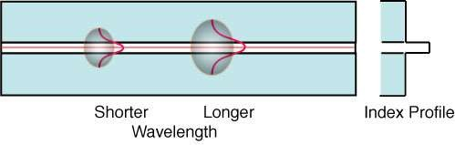
Waveguide Dispersion
This is due dispersive nature of the bound medium. In a bound medium like the optical fiber, the velocity is a function of frequency.
Figure 2.3 Waveguide dispersion [2]
Waveguide dispersion is chromatic dispersion which arises from waveguide effects: the dispersive phase shifts for a wave in a waveguide differ from those which the wave would experience in a homogeneous medium.

Slide 9
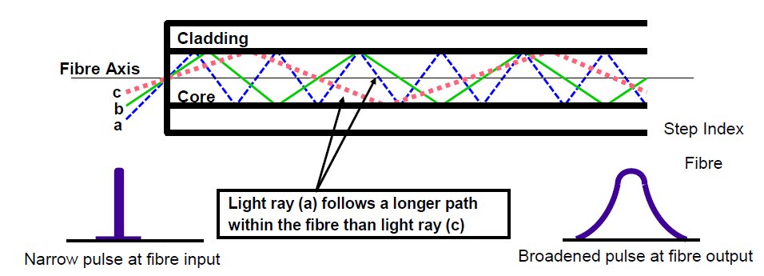
Intermodal or modal Dispersion
In a multimode fiber different modes travel at different velocities.
Figure 2.4 Modal Dispersion [2]

Slide 10
If a pulse is constituted from different modes then intermodal dispersion occurs.
Modal dispersion is greatest in multimode step index fibers.
The more modes the greater the modal dispersion.
Typical bandwidth of a step index fiber may be as low as 10 MHz over 1 km.
Attenuation in Optical Fibers
Attenuation limits the optical power which can reach the receiver, limiting the operating span of a system.
Once the power of an optical pulse is reduced to a point where the receiver is unable to detect the pulse, an error occurs.

Slide 11
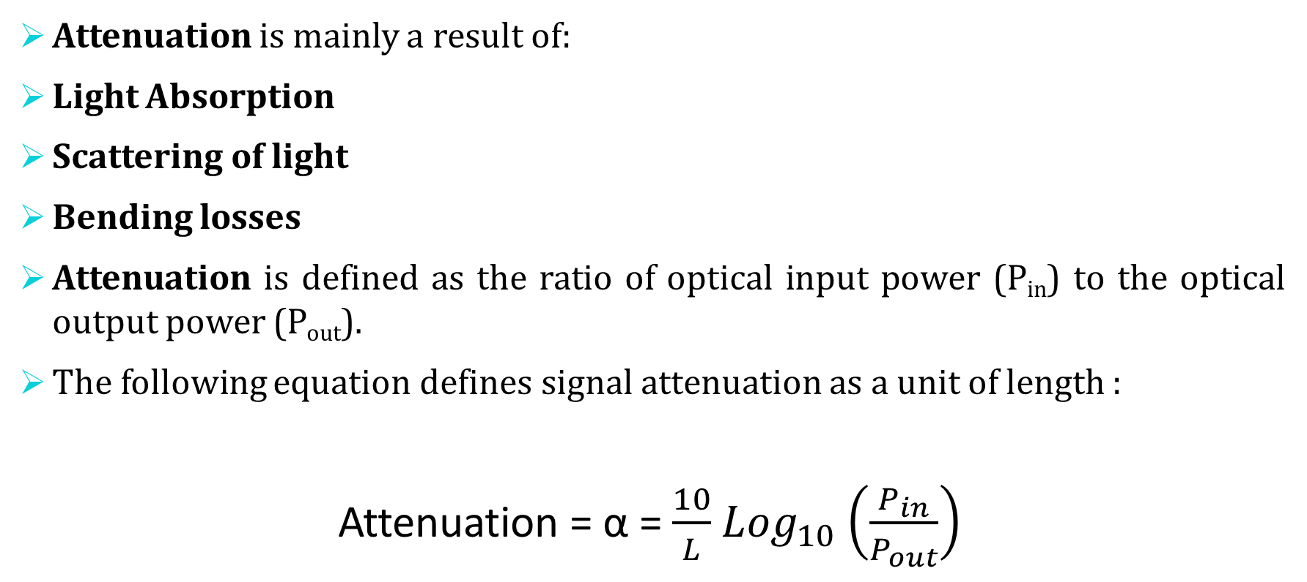
Attenuation is mainly a result of:
Light Absorption
Scattering of light
Bending losses
Attenuation is defined as the ratio of optical input power (P_{in}) to the optical output power (P_{out}).
The following equation defines signal attenuation as a unit of length :
Attenuation = α = $\frac{10}{L}$ ${Log}_{10}$ $\left(\frac{P_{in}}{P_{out}}\right)$

Slide 12
Types of Attenuation
Absorption Loss:
Caused by the fiber itself or by impurities in the fiber, such as water and metals.
Scattering Loss:
Intrinsic loss mechanism caused by the interaction of photons with the glass itself.
Bending loss:
Loss induced by physical stress on the fiber.

Slide 13
Material Absorption Losses
Material absorption is caused by absorption of photons within the fiber.
– When a material is illuminated, photons can make the valence electrons of an atom transition to higher energy levels
– Photon is destroyed, and the radiant energy is transformed into electric potential energy. This energy can then
Be re-emitted (scattering)
Frees the electron (photoelectric effects) (not in fibers)
Dissipated to the rest of the material (transformed into heat)
In an optical fiber Material Absorption is the optical power that is effectively
converted to heat dissipation within the fiber.
Two types of absorption exist:
– Intrinsic Absorption, caused by interaction with one or more of the components of the glass.
– Extrinsic Absorption, caused by impurities within the glass.

Slide 14
Intrinsic Absorption is caused by basic fiber material properties. If an optical fiber is absolutely pure, with no imperfections or impurities, ten all absorption will be intrinsic. Intrinsic absorption in the ultraviolet region is caused by electronic absorption bands. Intrinsic Absorption occurs when a light particle (photon) interacts with an electron and excites it to a higher energy level.
Extrinsic Absorption is caused by impurities caused by impurities introduced into the fiber material. The metal impurities such as iron, nickel and chromium are introduced into the fiber during fabrication. Extrinsic Absorption is caused by the electronic transition of these metal ions from one energy level to another energy level.

Slide 15
Fiber Bend Losses
Bending loss is classified according to the bend radius of curvature :
1. Microbend Loss 2. Macrobend Loss
Microbend Loss are caused by small discontinuities or imperfections in the fiber. Uneven coating applications and improper cabling procedure increases micro bend loss. External forces are also a source of micro bends.

Slide 16

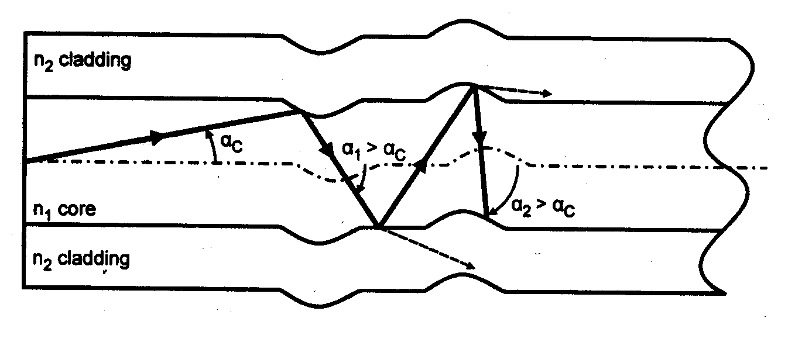

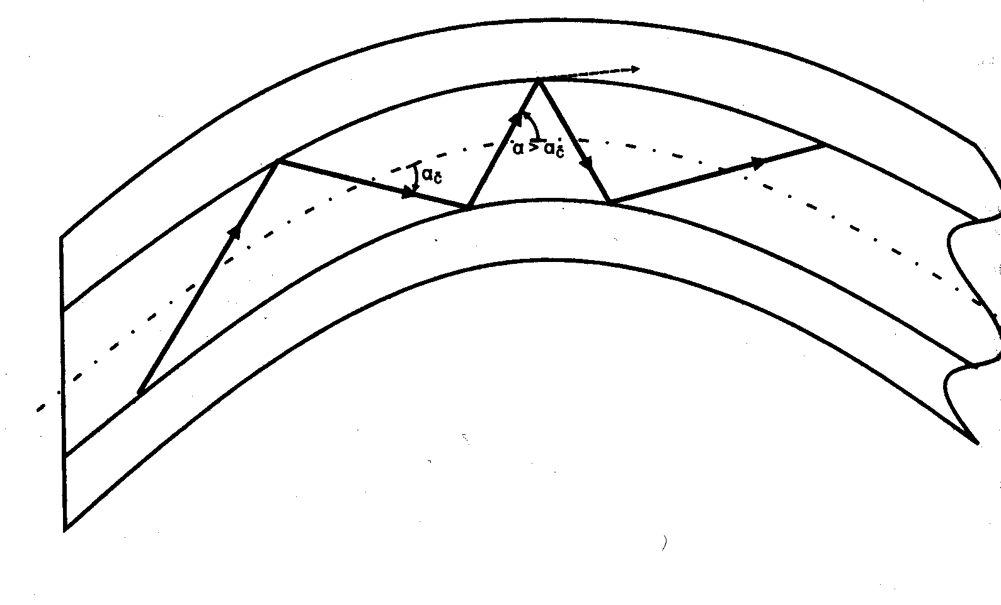
Macrobend Loss
Macrobend Losses are observed when a fiber bend’s radius of curvature is large compared to the fiber diameter. These bends are a great source of loss when the radius of curvature is less than several centimeters.
Figure 2.5 represent micro and macrobend in optical fiber [2]

Slide 17
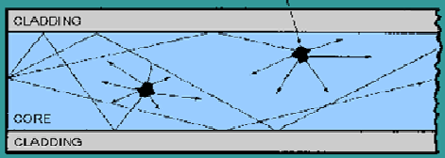
Linear Scattering Losses
Light scattering is a form of scattering in which light in the form of propagating energy is scattered.
Light scattering can be thought of as the deflection of a ray from a straight path, for example by irregularities in the propagation medium, particles, or in the interface between two media.
Deviations from the law of reflection due to irregularities on a surface are also usually considered to be a form of scattering.
When these irregularities are considered to be random and dense enough that their individual effects average out, this kind of scattered reflection is commonly referred to as diffuse reflection.
Figure 2.6 Light scattering [10]

Slide 18
Advantages of optical fiber communication
Increased Bandwidth and Channel Capacity
Low Signal Attenuation
Immune to Noise
No Crosstalk
Lower Bit Error Rates
Signal Security
Electrical Isolation
Reduced Size and Weight of Cables
Radiation Resistant and Environment Friendly
Resistant to Temperature Variations etc.

Slide 19
Disadvantages of optical fiber communication
Specialist skills needed
Cost of installation
Cost of transmission equipment from electrical to optical signals
Optical fibers can not carry electrical power

Slide 20
Applications of optical fiber communication
As fibers are very flexible, they are used in flexible digital cameras.
Fibers are used in mechanical imaging i.e. for inspection of mechanical welds in
pipes and engines of rockets, space shuttles, airplanes.
Fibers are used in medical imaging such as endoscopes and laparoscopes.
Fibers can be used under sea communication.
Fibers are used in military applications such as aircrafts, ships, tanks etc.

Slide 21
Nuclear testing applications use optical fiber phase sensors and transducers
Fibers are used in public utility organizations like railways, TV transmission etc.
Fibers are used in LAN systems of offices, industrial plants and colleges etc.
Fibers are used in telecommunication such as voice telephones, video phones, telegraph services, message services and data networks.

Slide 22
Summary
Brief Introduction
Optical fiber construction
Critical angle & Total Internal Reflection
Acceptance angle & acceptance cone
Numerical Aperture
V-Number
Types of fibers
Dispersion & its types
Attenuation and Losses in Fiber

Slide 23
Assessment Test
Quiz link for Assessment Test:-
https://docs.google.com/forms/d/e/1FAIpQLSdoaR30UPyyOY0IRVyChKPoZVB99BOTYyw61SPEVbYoxNepFQ/viewform?usp=pp_url
Home Assignment :-
Q.1 Give types of dispersion losses.
Q.2 What is macro and micro bend?

Slide 24
References
[1] https://www.ispreview.co.uk/index.php/2013/07/alcatel-lucent-breaks-record-with-31tbps-over-a-single-fibre-optic-cable.html
[2] http://constructionmanuals.tpub.com/14026/css/Fiber-Buffers-193.htm
[3] https://www.slideshare.net/ankushsaini123/6796optical-fibres
[4] https://www.slideshare.net/MadhumitaTamhane/optical-fiber-communication-part-1- optical-fiber-fundamentals
[5] (a) http://constructionmanuals.tpub.com/14026/css/Fiber-Buffers-193.htm
(b) https://computer.howstuffworks.com/fiber-optic2.htm
[6] https://www.slideshare.net/PratyushSrivastava8/optical-fiber-cable- v2?from_action=save
[7] https://www.ques10.com/p/21598/derive-the-expression-of-numerical-aperture- for-a-/
[8] https://www.explainthatstuff.com/fiberoptics.html
[9] http://fiberonda.com/single-mode-vs-multi-mode-fiber-optic-cable/
[10] https://images.app.goo.gl/LLWfgV3PjgLc9RbDA

Slide 25
Text book
Beiser A., Ghatak A, Garg S.C., Applied Physics, Edition 1st, (2013), Tata McGraw-Hill, Noida.
Laud B.B., Laser and Non -Linear Optics, Edition 1st, (1991), Wiley Eastern Ltd.
E- content
http://www.fiberopticshare.com/what-are-the-components-of-optical-fiber.html

Slide 26
THANK YOU
For Queries:-
deepak.e1972@cumail.in

